Slide 1
Strategeion Interview Prediction
Summative Capstone 26.05.2021
Nor Aza Hussain

Slide 2
Content
Introduction and Objective
Methodology
Process Workflow
Results
Conclusions
Future Opportunities
Appendix

Slide 3
Introduction
Brief history about the company
A small enthusiastic group of Army veterans co-founded a non-profit company, Strategeion, after leaving the military. Building on their previous experiences supporting various military operations with IT solutions, this group of programmers set out to create jobs for themselves and improve the lives of others by producing an online platform that would enable veterans to stay in touch with their cohorts and share experiences dealing with civilian life. They found sudden fame and more people wants to work in Strategeion.
WHO AM I?
HR Recruiter working for Strategeion
Due to recent company growth and expansion, looking to hire more people thus a lot of resumes were sent in
Task with hiring personnel for the company
Only interested in people who fits and likely to pass the job interview based on their skills written on the resume
→ AIM: To predict if the resume will lead to a successful interview and be hired!

Slide 4
Objective
To predict if the resume will lead to a successful interview and be hired!
Learn about the relations between variables and develop a predictive model

Slide 5
Process Workflow

Slide 6


Process Workflow
1.Formulate the hypothesis/objective.
2.Use data already used in one of the previous capstone projects. Identify the inputs and output(s) from that data. If not possible, gather new data.
3.Clean & Transform the data as required
4.Perform Feature Engineering
5.Build Machine Learning Models
6.Compare various Machine Learning Models using performance metrics
7.Optimize the model if required
8.Explain the end result. Circle back to the objective.

Slide 7
Methodology
Dataset (from Kaggle)
Title: Strategeion Resume Skills
Source:
https://www.kaggle.com/vingkan/strategeion-resume-skills
Programming Tools:
MSSQL
Python
Jupyter
Matplotlib
Seaborn
Pandas
Numpy
Sklearn
Presentation Tools:
PowerPoint
PowerBI
Models used:
Baseline model: Logistic Regression
Random Forest Classifier
Logistic Regression (Optimized)
Metric: Classification problem
Accuracy
Precision
Recall
F1-Score
AUC/ROC

Slide 8
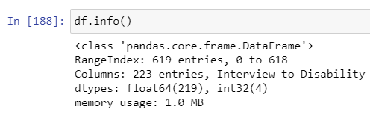
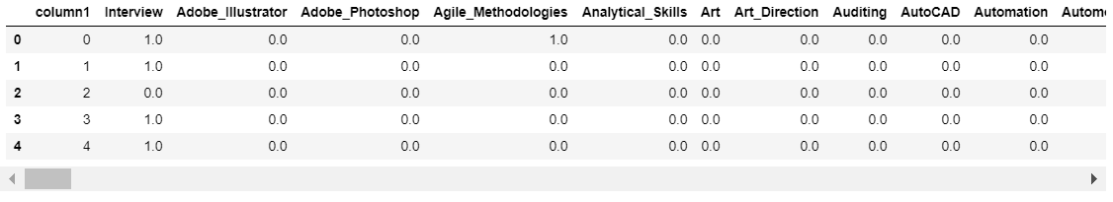
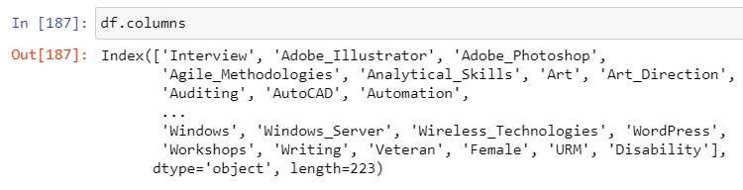
Dataset
1 CSV file
Binary data
223 columns
Input Attributes:
4 Demographics
218 Skills
1 Output Target (Interview)
Number of instances : 619

Slide 9
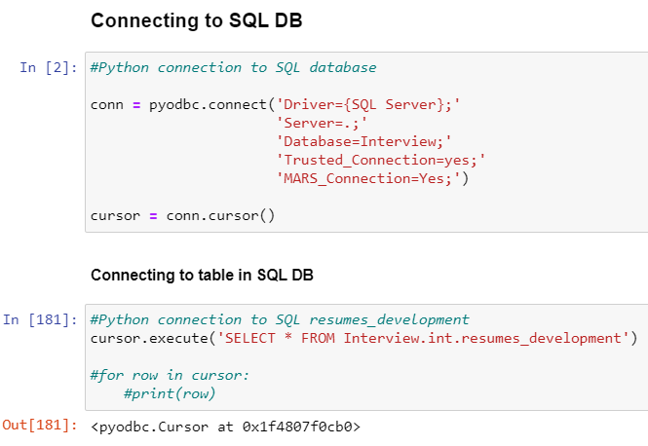
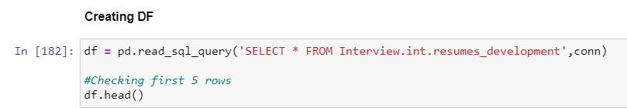
Process Workflow
Loading and Python-Interview DB SQL Connection
Create Interview Database folder and Schema int in MSSQL
Import CV file to Interview Database
Connect Jupyter Notebook to SQL via pyodbc
Create dataframe for the csv file

Slide 10
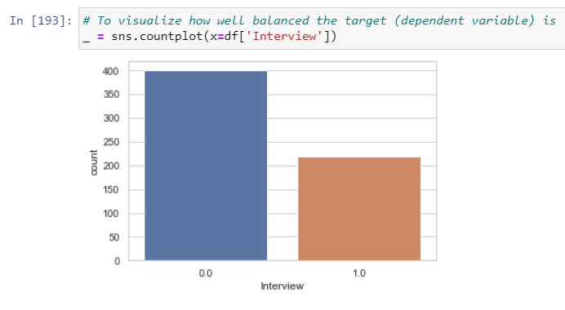
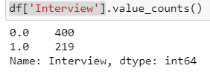
Process Workflow
Data Preparation
Changing Boolean features (True/False) to integers (personal preference, looks cleaner since other features are binary)
Drop ‘column1’ from df
Check if dataset is imbalanced

Slide 11
Feature Engineering & Data Transformation
Splitting the data into independent X and dependent y attributes
Independent attributes: 222 skills features
Drop feature ‘Interview’
Target: ‘Interview’
Split data into training and testing datasets
Test size = 0.3
Feature Selection via SelectKBest (chi2 method) (k=20)
Due to large number of independent attributes, need to choose the features which contribute the most to the target variable
From 222 → 20

Slide 12
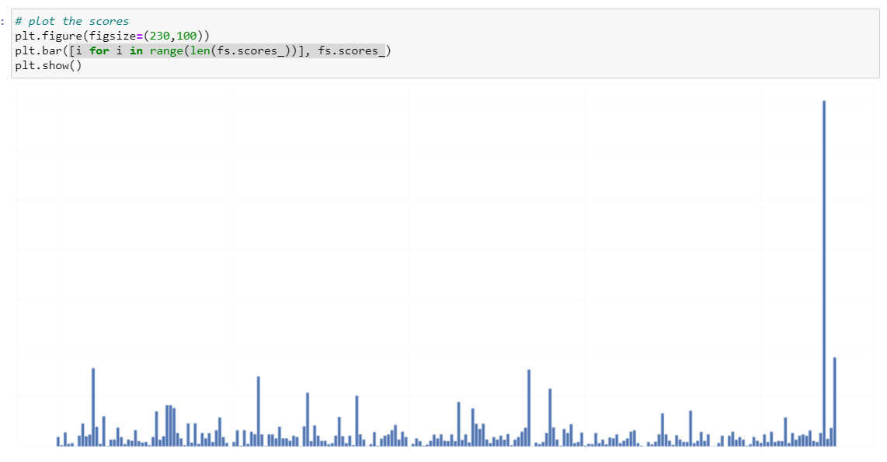
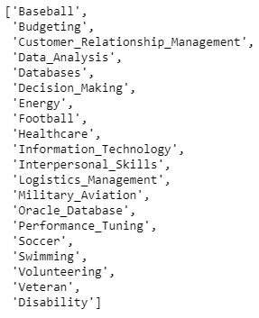
SelectKBest(score_func=chi2, k=??)
Finding appropriate k value
SelectKBest(score_func=chi2, k='all')

Slide 13
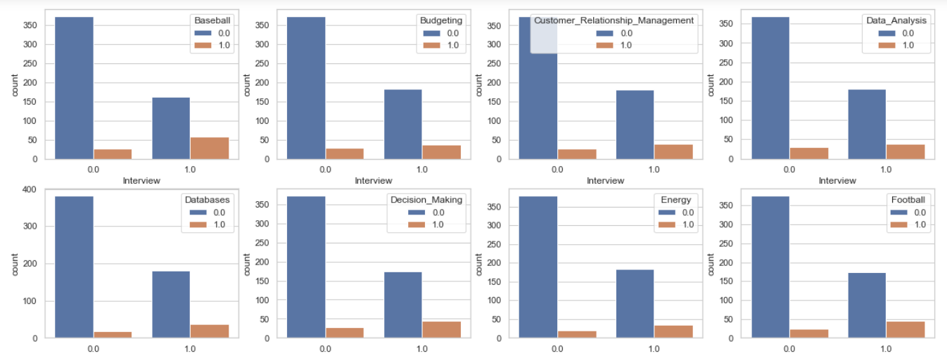
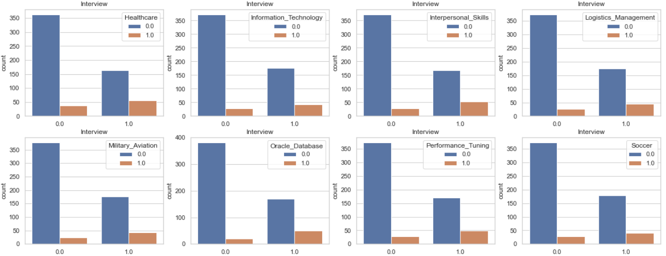
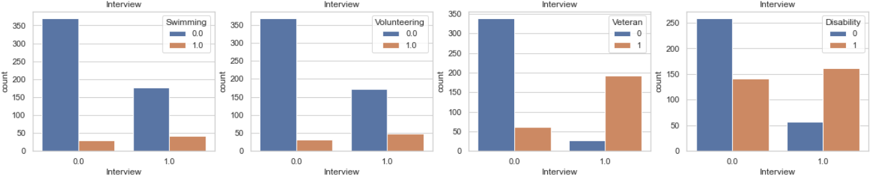
Analysis

Slide 14
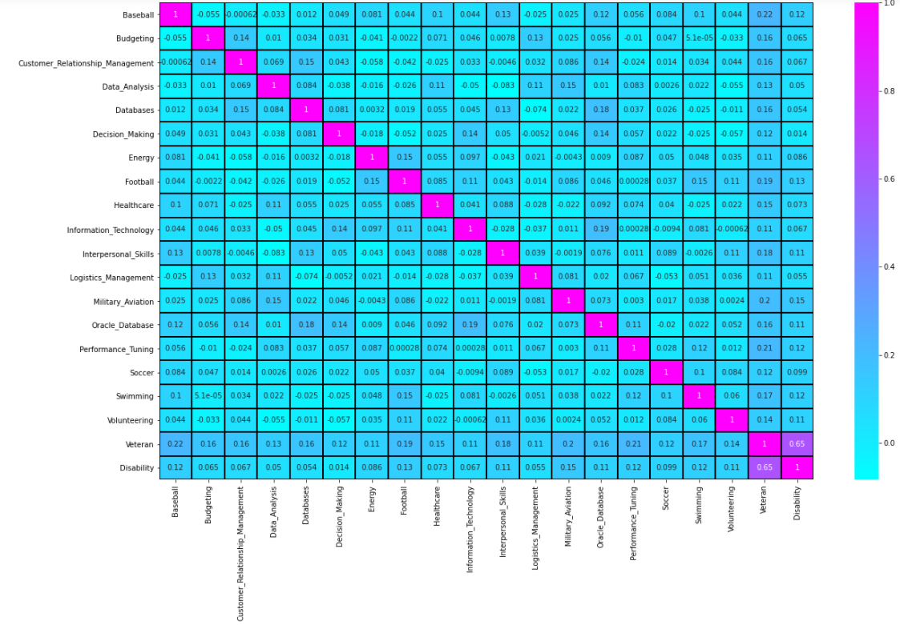

Slide 16
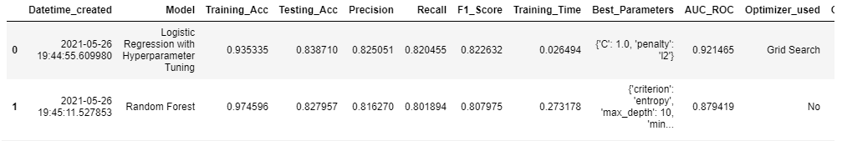
ML Model Performance Results
Best Model: Logistic Regressor (Baseline model)
Highest F1-score → higher recall AND precision

Slide 17
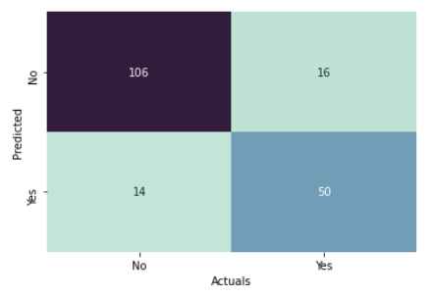
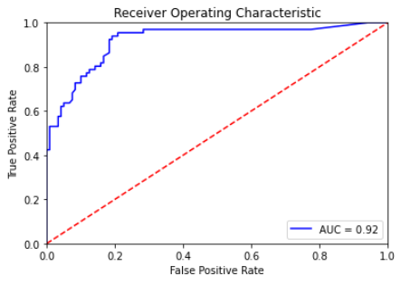
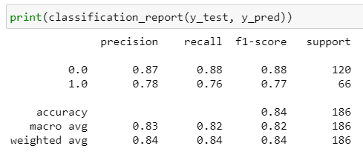
ML Model Performance Results
Model: Logistic Regressor (optimized)

Slide 18
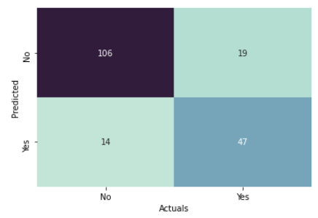
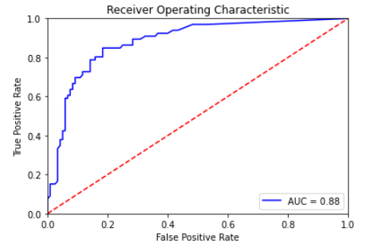
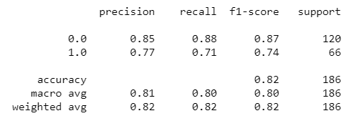
ML Model Performance Results
Model: Random Forest Classifier

Slide 19
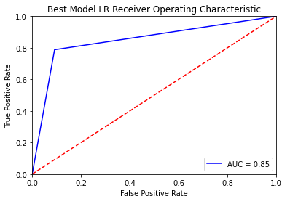
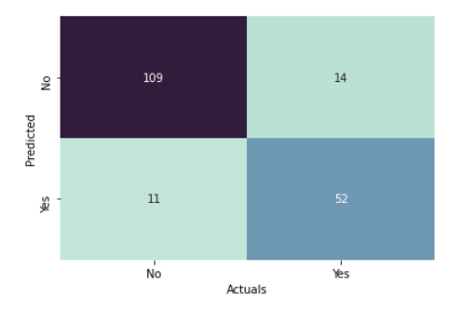
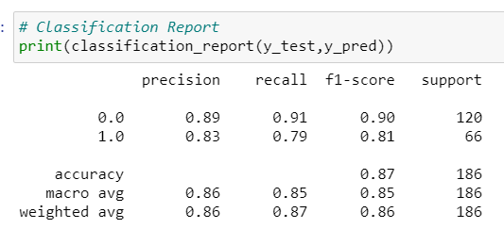
Conclusion
Best Model : Logistic Regression
F1 Score: 0.90
AUC = 0.85
As the dataset is not highly imbalanced and performance of the model is more important in order to correctly predict if the candidate’s resume will end with a successful interview or not
So that the person for the right fit is chosen
However, this also highlight another potential issue regarding the feature importance

Slide 20
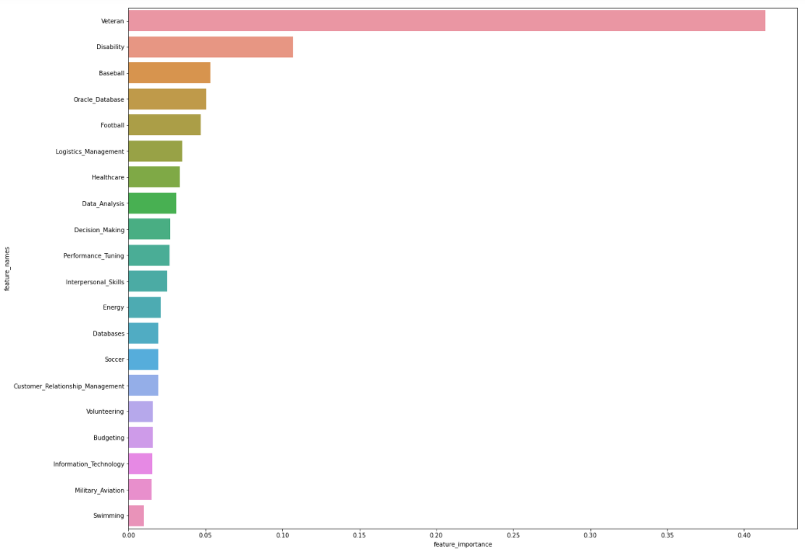

Slide 21
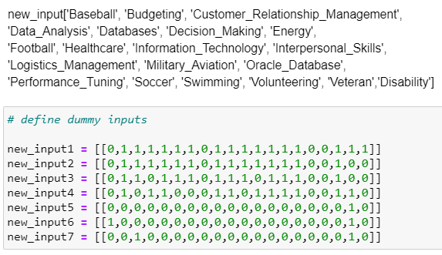
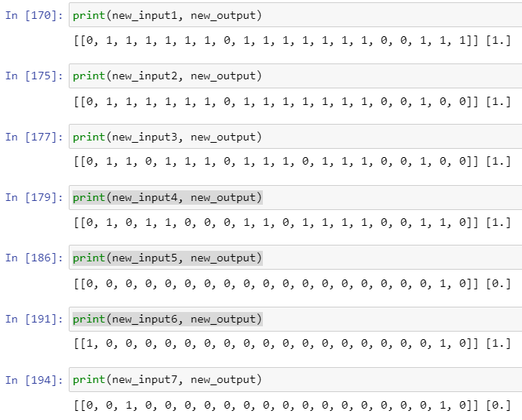
Extra inputs for prediction

Slide 22
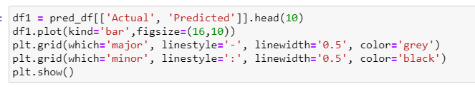
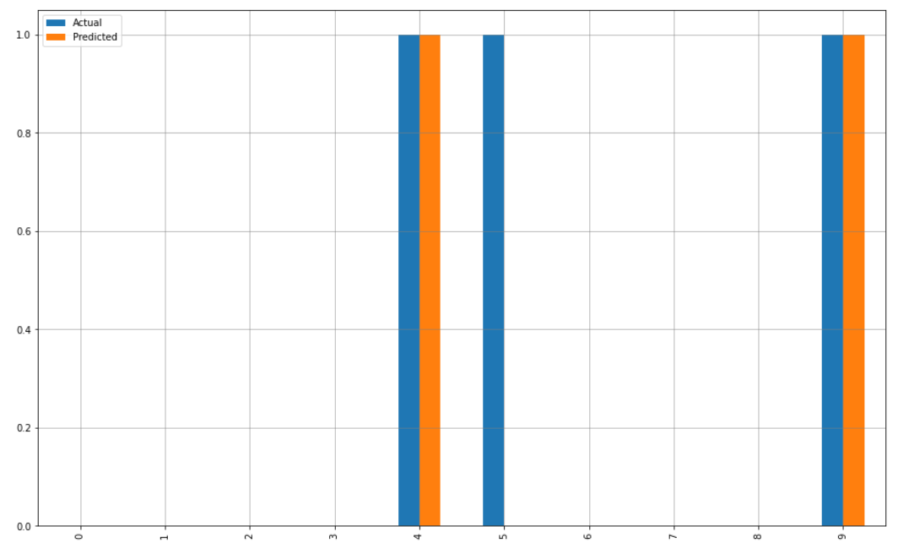

Slide 23
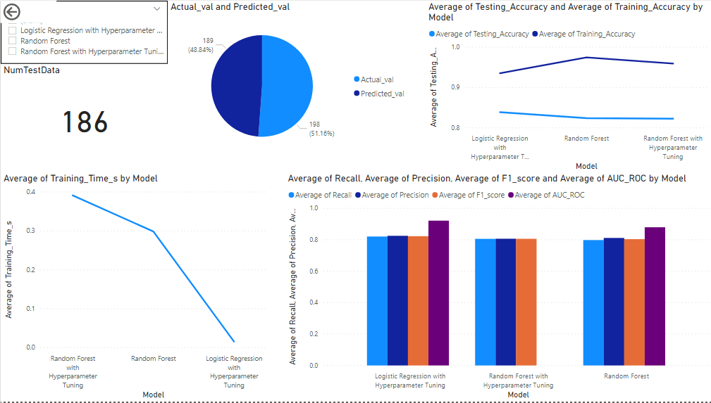
Power BI

Slide 24
Future Opportunities
Include more classification models
1
Gather more data to employ Neural Network models like MLP etc
2
Use different types of feature selection tools like wrapper/filter method
3
Explore the features further to get more insights
4

Slide 25
Appendix
https://www.kaggle.com/vingkan/strategeion-resume-skills
https://aiethics.princeton.edu/wp-content/uploads/sites/587/2018/12/Princeton-AI-Ethics-Case-Study-5.pdf

Slide 26
Thank you! Q & A
Thank You!

Slide 27
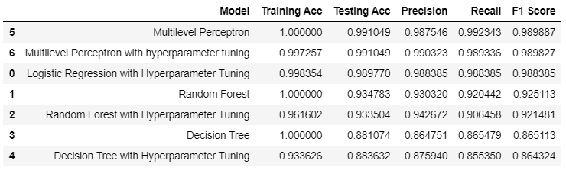
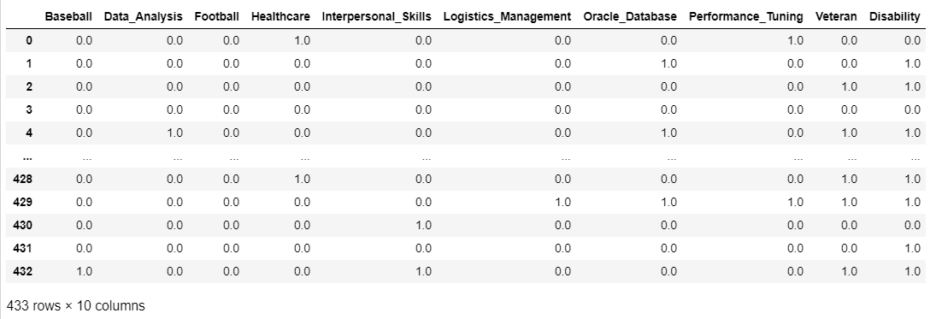
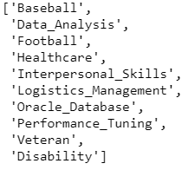
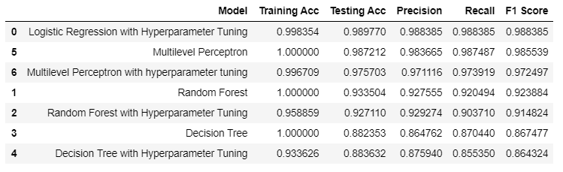

Slide 28
